Slide 1
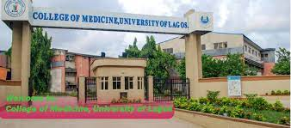

TISSUE PROCESSING
MLS 334
3 UNIT
OSIAGWU DANIEL

Slide 2
OBJECTIVE
At the end of the class
know what tissue processing is
Principle of tissue processing
Types of tissue processors
Osiagwu Daniel

Slide 3
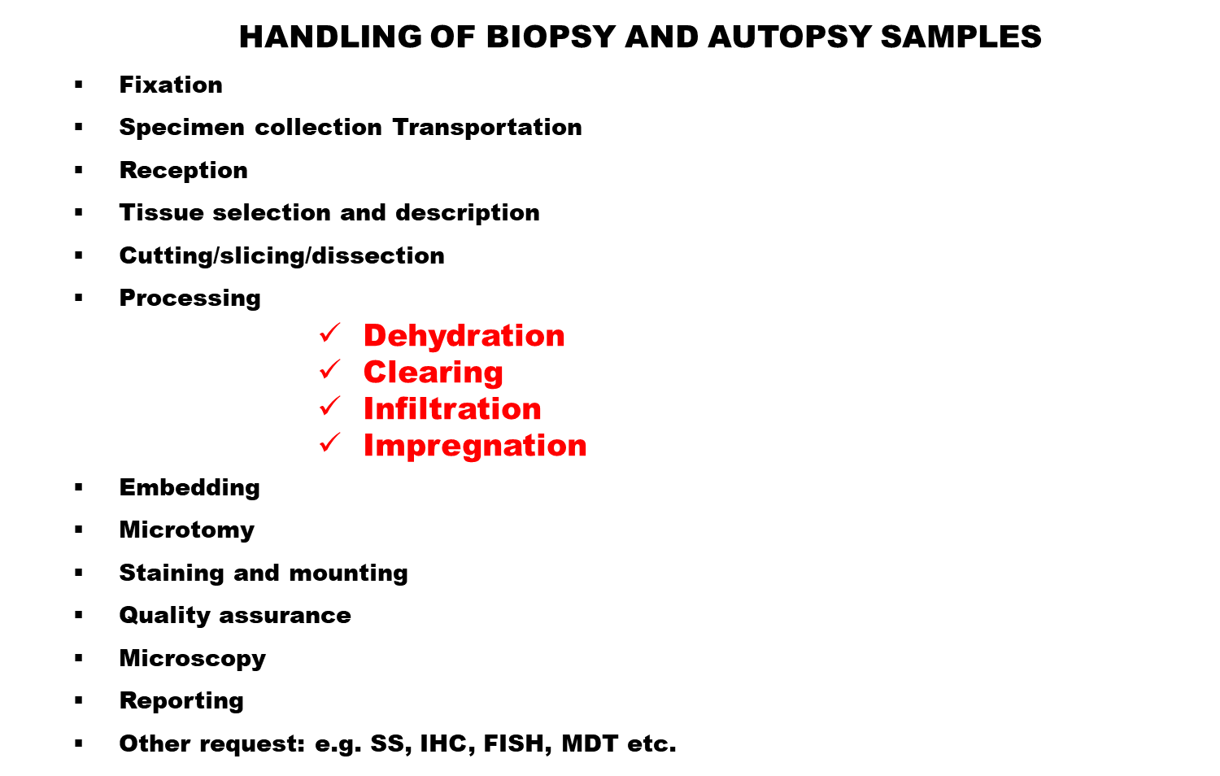
Osiagwu Daniel

Slide 4
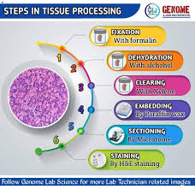
Osiagwu Daniel

Slide 5
INTRODUCTION
When a tissue sample is removed from a patient, to turn it into final microscopic slide of good diagnostic quality. It has to pass through a series of processes.
These processes includes –
        Fixation
        Dehydration
        Clearing
        Infiltration/Impregnation
Each of these step is very important from the point–
Osiagwu Daniel
Notes:
osiagwu Daniel

Slide 6
      Procurement of specimen
      Selection of the sample
      Protocol determination
      Reagents to use
      Staining
      Final diagnosis
The quality of the structural preservation of tissue components is determined by choice of reagents and exposure time in the reagent during processing.
Osiagwu Daniel

Slide 7
LABELING OF TISSUE
Unique code or identification number is assigned to each tissue sample in the laboratory.
They may be manually or electronically generated.
Bar codes and character recognition systems are now common with most laboratories.
Automated pre-labeling systems etch or emboss tissue cassettes or slides permanently.
Chemically resistant:
        Pens
        Labels
        Slides
        Pencils
Osiagwu Daniel

Slide 8
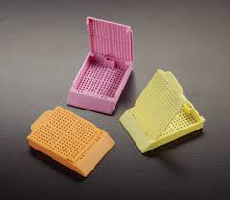
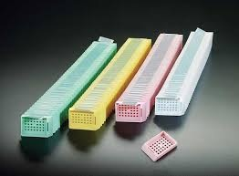
Tissue cassettes by thermo scientific
Osiagwu Daniel

Slide 9
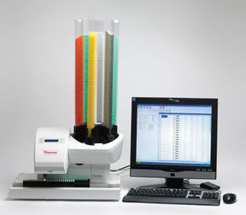
Tissue cassette writer by thermo scientific ltd.
Osiagwu Daniel
Notes:
osiagwu Daniel

Slide 10
WHAT IS TISSUE PROCESSING?
Tissue processing refers to treatment of tissue by passing it gradually through series of reagents necessary to impregnate it into a solid medium so that the tissue is rendered sufficiently firm yet elastic for tissue sections of desirable thickness to be cut on a microtome.
The fixed impregnated tissues have an advantage that they can be easily preserved and are reproducible.
Other techniques employed for tissue sections to be produced for microscopy.
Osiagwu Daniel

Slide 11
Sections can also be produced by frozen section method using either
    cryostat or
    freezing microtome.
ADVANTAGES OF FS:
    Rapid processing time
    Less equipment required
    Less need for ventilation in the laboratory.
DISADVANTAGE –
  Poor quality of the final slide.
  Used in intra-operative pathology to determine the next step in surgery.
  To preliminarily determine whether the resection margins are cleared of a tumor during surgery
Osiagwu Daniel

Slide 12
PRINCIPLE OF TISSUE PROCESSING
Tissue processing is designed to remove all extractable water from the tissue.
The water is then replaced with a solid support medium.
The medium provides it with sufficient rigidity to enable sectioning of the tissue with out distortion or damage.
Most tissue fixatives are aqueous fixatives, hence for proper embedding of tissue in paraffin wax it is necessary that the water, some lipids and other tissue fluids be removed completely by a variety of compounds.
Osiagwu Daniel
Notes:
osiagwu Daniel

Slide 13
STAGES OF TISSUE PROCESSING
  Complete fixation
  Dehydration
  Clearing
  Infiltration/Embedding
Complete fixation – post fixing
Dehydration - removal of water an fixative
Clearing – removal of dehydrating solutions, making the tissue receptive to infiltrating solutions.
Infiltrating- permeating the tissue with a support medium.
Embedding – orientating the tissue sample in a support medium and allowing it to solidify.
Osiagwu Daniel
Notes:
osiagwu Daniel

Slide 14
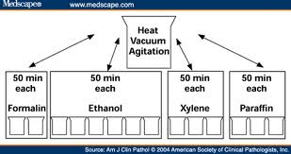
Schematic representation of the conventional overnight tissue processing
Osiagwu Daniel

Slide 15
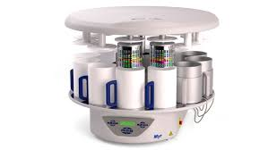
Osiagwu Daniel

Slide 16
FACTORS INFLUENCING THE RATE OF PROCESSING
When tissue is immersed in fluid, interchange occurs between the fluid within the tissue and the surrounding fluid.
AGITATION:- Increases the flow of fresh solutions around the tissue.
- The rate of fluid exchange is dependent upon the exposed Surface of tissue in contact with fluid.
- Rotary or vertical oscillation or pressurized removal/replacement of fluid at timed intervals is the mechanism for agitations.
- Agitation can reduce overall processing time by 30% if efficient.
HEAT : - Increases the rate of penetration and fluid exchange.
- Most be used carefully to prevent and reduce shrinkage, hardening and brittleness of the tissue.
Osiagwu Daniel

Slide 17
- Temperature limited to 45⁰C can be used effectively, higher temps may have effect on IHC staining.
VISCOSITY: - Is the property of fluid that resists flowing: the property of a fluid or semifluid that causes it to resist flowing.
- The rate of fluid penetration is faster if the size of the molecules in the fluid is smaller.
- If the molecular size is larger, the rate of exchange is slower.
- Clearing and dehydrating agents have same viscosity, while paraffin has lower viscosity.
VACUM: -
  Using reduced pressure to increase the rate of infiltration decreases the time necessary to complete other steps in tissue processing
Osiagwu Daniel

Slide 18
TYPES OF TISSUE PROCESSOR
  Closed Linear Tissue Processing Canter
  Carousel Automatic Tissue Processor (open/closed)
  Vacuum Tissue Processor
  Rapid Multifunctional Tissue Processor
  Rapid Multifunctional Microwave Processor
PARTS OF A TISSUE PROCESSOR
  Reagent baths
  Power sources
  Alarm mechanism
  Timer
  Automatic transfer mechanism
  Agitation mechanism
  Wax bath
  Delay mechanism
Osiagwu Daniel

Slide 19
TISSUE PROCESSORS
Tissue processors are instruments used to prepare tissue samples for analysis by fixing, dehydrating, clearing and infiltration. they help to achieve high-quality histology and efficient laboratory workflow.
The carousel-type processors were the first type of automatic tissue processors.
Then came the enclosed self-contained vacuum infiltration tissue processor.
Recent advances has also led to the production of specialty microwave oven processors and continuous in-put rapid tissue processors.
Recent processors employ microprocessors used to programme the instrument.
Osiagwu Daniel

Slide 20
They also employ alarm system and diagnostic programs for trouble-shooting malfunction of the instrumentation.
The advantages of recent systems are that:
  They use Vacuum
  Heat can be applied at any stage
  No spillage of fluids (contained)
  No fume
  They save time (Microwave oven) from hrs to min.
The continuous in-put rapid tissue processors, uses microwave technology, vacuum infiltration and reagents that are molecular-friendly.
It uses isopropanol, acetone, Polyethylene glycol, mineral oil and paraffin.
Osiagwu Daniel

Slide 21
Microwave and agitation are used to accelerate rate of diffusion of solvent in tissue.
Advantages of the continuous in-put rapid tissue processors.
  Acceptance of tissue samples into the system at timed intervals
  Improved turn around time
  Environmentally safe and friendly reagents
  Eliminating toxic vapours
  Good morphology and quality of the specimen consistent with that of traditional tissue processing.
Disadvantages
    Cost of the tissue processor.
    Grossing of tissue samples.
Osiagwu Daniel

Slide 22
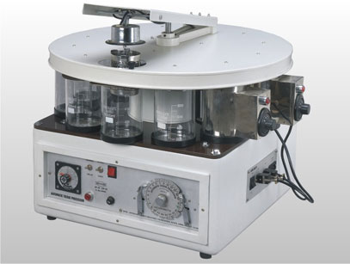
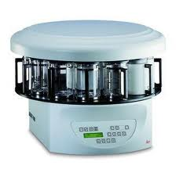
Automatic Tissue Processor
PARTS OF A TISSUE PROCESSOR
Reagent baths, Power sources, Alarm mechanism, Timer
Automatic transfer mechanism, Agitation mechanism
Wax bath, Delay mechanism
Osiagwu Daniel

Slide 23
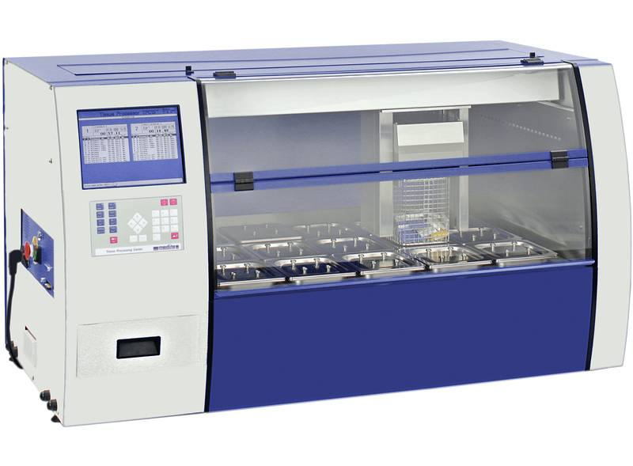
TPC 15: Closed Linear Tissue Processing Canter
Osiagwu Daniel

Slide 24
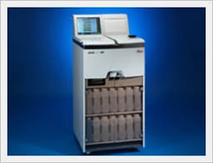
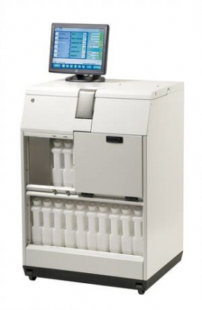
Vaccum Tissue Processor
Osiagwu Daniel
Notes:
osiagwu Daniel

Slide 25
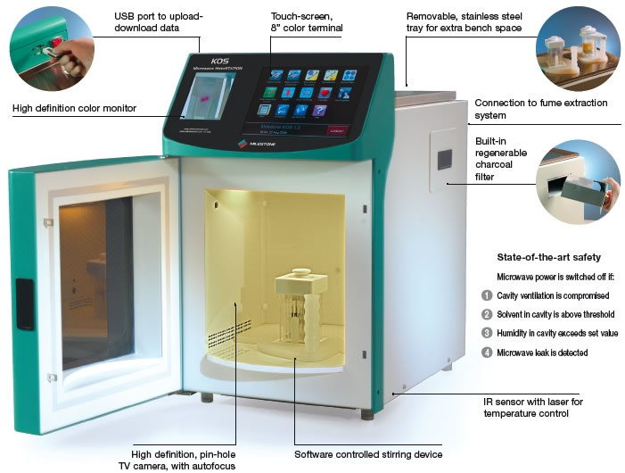
KS: Rapid Multifunctional Microwave Processor: processing: hours, not days! Bone marrow ; Rapid bone decalcification; transplants biopsies; Special stains .
Osiagwu Daniel
Notes:
osiagwu Daniel

Slide 26
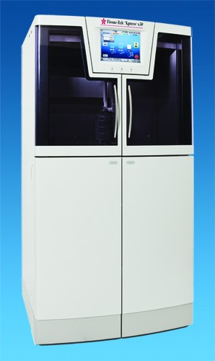
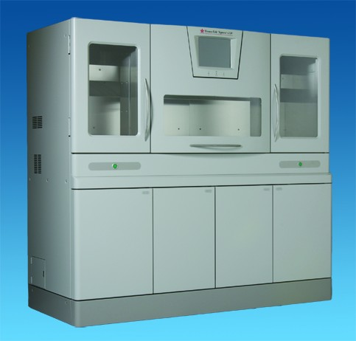
The Tissue-Tek® brand Xpress® x50 processor and Tissue-Tek® brand Xpress® x120 rapid tissue processor.
Osiagwu Daniel
extww02a.cardinal.com
Notes:
osiagwu Daniel

Slide 27
References
1. Bancroft, J.D. and Gamble. M., (2008) Theory and Practice of histological techniques ed. 6th, Churchill Livingstone inc. . Edinburgh. London, Melbourne and New York.
Bancroft, J.D. and Stevens, A.: theory and practice of histological
techniques ed.3, Churchill Livingstone inc. 1990. Edinburgh. London,
Melbourne and New York.
2. Avwioro, O.G. , Histochemistry and tissue pathology principle and techniques. , Ed. 1 Claverianum Centre. P.O. Box 4017. U.P.O., Ibadan
3. Horobin, R.W. (2002) Theory of staining and its practical implications. In Theory and Practice of Histological Techniques, 5th edn (eds J.D. Bancroft and M. Gamble). Edinburgh: Churchill Livingstone.
4. Kiernan, J.A. (2001) Histological and Histochemical Methods, 3rd edn. Oxford: Hodder Arnold.
www.leicamicrosystems.com
www.google.com.ng/images
www.medscape.com
Osiagwu Daniel

Slide 28
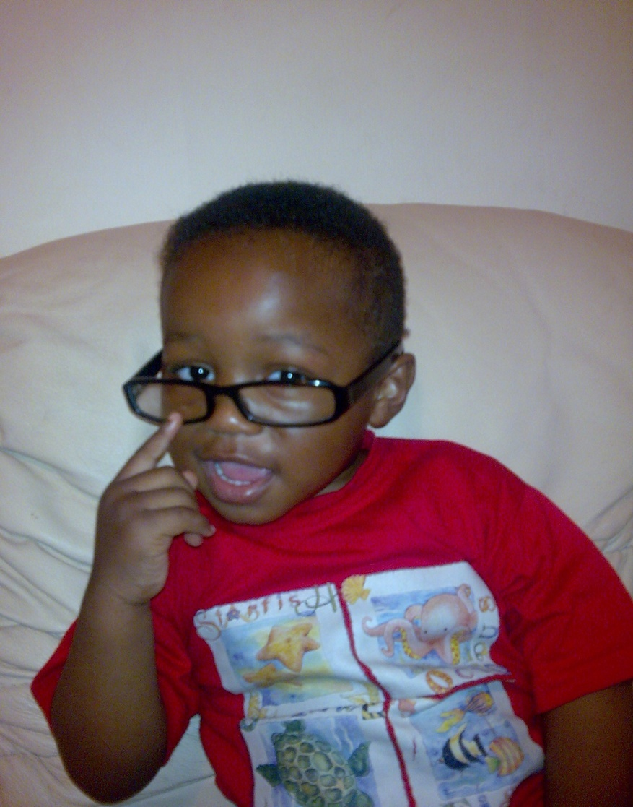
“ LIFE IS THE MOST DIFFICULT EXAM, MANY PEOPLE FAIL BECAUSE THEY TRY TO COPY OTHERS, NOT REALIZING THAT EVERYONE HAS A DIFFERENT QUESTION PAPER”
THANK YOU.
DANIEL: 27/03/2016 4:20 AM

Slide 29

THANK YOU
QUESTIONS & COMMENTS
Osiagwu Daniel
Notes:
osiagwu Daniel

